Slide 1
Simulation Training to Interrupt Microaggressions
Pre-Brief
Notes:
(SUSH adjusted title)

Slide 2
Schedule
Please self-regulate your need for breaks outside of designated times
1:00-1:15 Arrival and Pre-Brief
1:15-1:25 Independent Review of Microaggressions
Handout focusing on p 5-6
1:30-2:00 Simulation Round 1 + Debrief
2:05-2:35 Simulation Round 2 + Debrief
2:40-3:10 Simulation Round 3 + Debrief
3:15-3:45 Simulation Round 4 + Debrief
3:45-4:00 Final Reflections & Evaluation
Completion
Members of our project team will observe portions of today’s pilot to advise us on process and curriculum, and to provide feedback to our debriefers. We are NOT evaluating your performance!
Notes:
You will be divided into 4 groups. Each person in your group will get to be the “interrupter” during at least one of the scenarios. When it is not your turn, you will be watching from the other side of the window. Due to space concerns, some of the sessions today will occur outside of the sim center– for these you will serve as an “invisible” observer from a different corner of the room– the SP and the resident participating in the sim will pretend you are not there (you are not part of the sim).
There will be a debrief after each simulation. Everyone will participate in the debrief, sharing observations as the learner, observer, SP, and/or facilitator.
Rooms will be 1A in the CSP, this room (MPR), G5/170, and G5/114. Claudia will help guide people to the right rooms, especially in the G5 module, and there will be signs on the doors

Slide 3
Microaggressions
Everyday slights, indignities, put downs and insults that Black, Indigenous, and other People of Color (BIPOC) and others who have been historically marginalized experience in their day-to-day interactions.
Microaggressions are rooted in a power differential; unique to historically marginalized identities
Tend to be Subtle, Unintentional, Indirect
Often occur in situations where there are alternative explanations
Can represent unconscious beliefs
Behavioral Expression of Bias
Notes:
Everyone here today has already engaged in some microaggression training, so we will not be repeating basic microaggression training today. This slide is offered simply as a reminder and frame to ensure we are all working from a similar definition.
Does anyone have anything they would like to add to this definition?

Slide 4
Overarching Session Goals
Intervene in a non-confrontational way
Practice in the context of various power dynamics
Integrate brief interruption into a busy situation
Develop language that feels authentic to oneself and can be used in a variety of situations
Apply already-familiar techniques, such as those used to teach patients/families or to navigate a challenging clinical conversation
Redirect a conversation back to the topic at hand after interrupting a microaggression
Notes:
These are the overarching goals for today’s work. These goals and scenarios were developed based on focus group feedback from residents and faculty
We have tried to focus on common themes, and addressing challenges that came up repeatedly during the focus groups
Each encounter has its own objectives

Slide 5
Community Agreements…
Speak your truth without blame or judgement:
  No one speaks for an entire group.
  Be open about thoughts and feelings and not just saying what you think others want to hear.
  Normalize that you will have emotional responses to some of the topics.
  Encourage taking responsibility for only yourself, notice a tendency to blame or judge, and let this go to stay engaged.
Listen fully, with our ears, eyes and heart to learn from one another:
  No one comes to these conversations as experts.
  We are all learning about one another and the differences we bring to the conversation.
  Assume that we are all learning together.
  Notice the amount of space you are taking up in the room. Create space for others to speak
Be open to hearing experiences and viewpoints different from your own
Notice moments of discomfort. Stay curious & engaged:
  Remain morally, emotionally, intellectually, and socially involved in the dialogue
  Acknowledge that discomfort is inevitable
  Commit to bringing issues into the open
  Acknowledge that divisiveness already exists in society. It is through dialogue, even when uncomfortable, that healing and change begin.
Expect and accept non-closure:
  Be willing to ”hang out in uncertainty”
  Do not rush to quick solutions
What’s said here stays; what’s learned should leave:
  Maintain confidentiality outside of the dialogue.
  Do not rehash conversations or share personal stories of others outside of the agreement space.
  Share the learning that happened-- just take the individual out of it
Notes:
Here is a reminder of the community agreements you and your colleagues have come up with. Take a moment to review.
(ask for any Q’s, concerns, additions, etc.)

Slide 6

Opting Out: 4 Considerations
Your identity, and relationship to power/privilege position
Why
opting
out?
Costs of
staying
Impact of
leaving
Notes:
Reminder of our considerations if you are going to opt out. This includes when you choose to take a bathroom or other personal break.

Slide 7

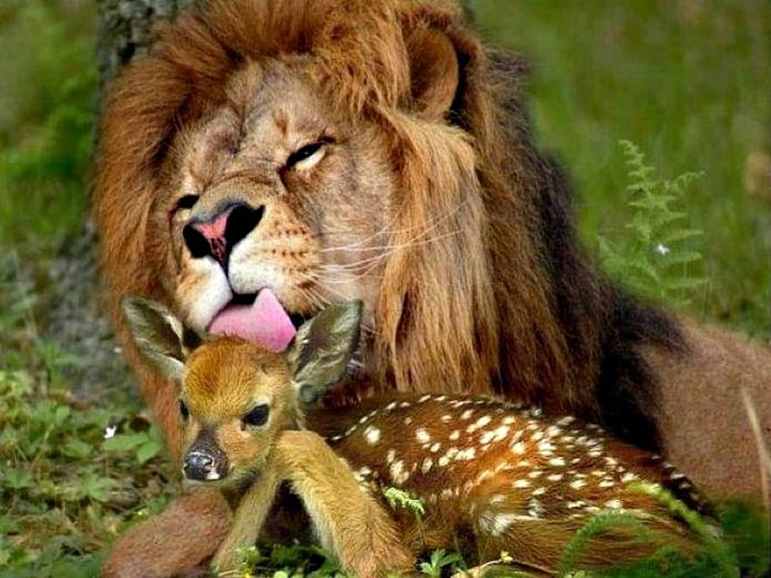
Notes:
Today, we expect there to be some challenges– during the simulations, during the debrief, or both.
Embrace the challenge. Be the deer. Get outside of your comfort zone– this is a safe space! (OK, that little deer might not be that safe! But you are safe here!). Bring your growth mindset.
(Click) we’re going to imagine the relationship between these two ends like this. Taking the risk pays off.

Slide 8
Microaggression Simulation Logistics

Slide 9



Microaggression simulations: Logistics
You will get brief background information before you enter the room
Approach the scenario as a typical workplace encounter, suspend disbelief and support the fiction contract
      Grounded in real life situations from focus groups
      We are not trying to trick you!
SP or facilitator will eventually end the scenario if you do not
      May be quite short
      May not have a satisfying conclusion
Notes:
One of our objectives is to build skill identifying microaggressions. If you miss it– there is important learning there too!
Note that these are all grounded in real scenarios that have happened to our residents and faculty, gleaned from focus groups
We are not trying to trick you! Microaggression may not occur right away, or even possibly until you feel there’s been a conclusion.
If you’ve reached a natural conclusion, end the encounter as you would in a natural clinical environment, even if you do not feel you have “found” the microaggression
Some of these scenarios are designed to have a predetermined outcome regardless of how you as the participant respond to a microaggression. Just like real life, not all conversations will have a conclusion that feels satisfying or provides closure.

Slide 10
Microaggression simulations: Logistics
Scenarios include a participant, an active observer, SP, and a facilitator
  Each learner will be the simulation participant in at least 1 scenario
Some scenarios may have time for a re-do after debrief
  Initial participant always has first right to re-do
  If things went very well the first time, a different participant can try the re-do
Debrief will occur with the facilitator, participant, observer(s), and sometimes the SP
  Observer(s) should actively imagine how they might approach the scenario be ready to provide feedback to the participant

Slide 11
Microaggression Simulation Tips

Slide 12




Tips for Participant
Authenticity
      Experiment with what feels right to you!
Efficient
      The interruption does not need to be a drawn out conversation
Non-confrontational
      Try not to escalate the situation or put the aggressor on the high-defensive
Direct
      Should be obvious to observers that you have noticed and addressed the microaggression.
Notes:
One of our objectives is to build skill identifying microaggressions. If you miss it– there is important learning there too!

Slide 13


Tips for Observers
Authenticity
      Notice language that you might like to try
Plus
      What does the participant do well? Consider verbal and nonverbal aspects
Delta
      What do you think could be done differently?
Emotions
      Observe your own emotional response. Practice empathy: how would you feel in this situation if you were in the position of the SP or the bystander?
Notes:
One of our objectives is to build skill identifying microaggressions. If you miss it– there is important learning there too!

Slide 14


Facilitator and SP Roles
Facilitator role:
  Maintain psychological safety within the group
  Ask questions
  Ensure everyone has a chance to participate
  Have all the answers
  Be the “expert” on interrupting microaggressions
SPs:
  Difficult roles to inhabit!
  SP joining debrief or not? 🡪 based on optimizing psychological safety
  If you inadvertently committed or perpetuated a microaggression during the session, debrief is opportunity to tend to the SP’s emotional state
Notes:
(SUSH'S NOTES: Not sure we need facilitator role here, could replace with more about active observation (Observing resident should actively imagine how they might approach the scenario being observed, and be ready to provide feedback to the participating resident))

Slide 15
Review pages 5-6
“Tools for Interruptions”
Take this with you and reference through the day, as an observer and when you are in the debriefs.
For authenticity, try not to refer to this while you are the active participant.

